Slide 1
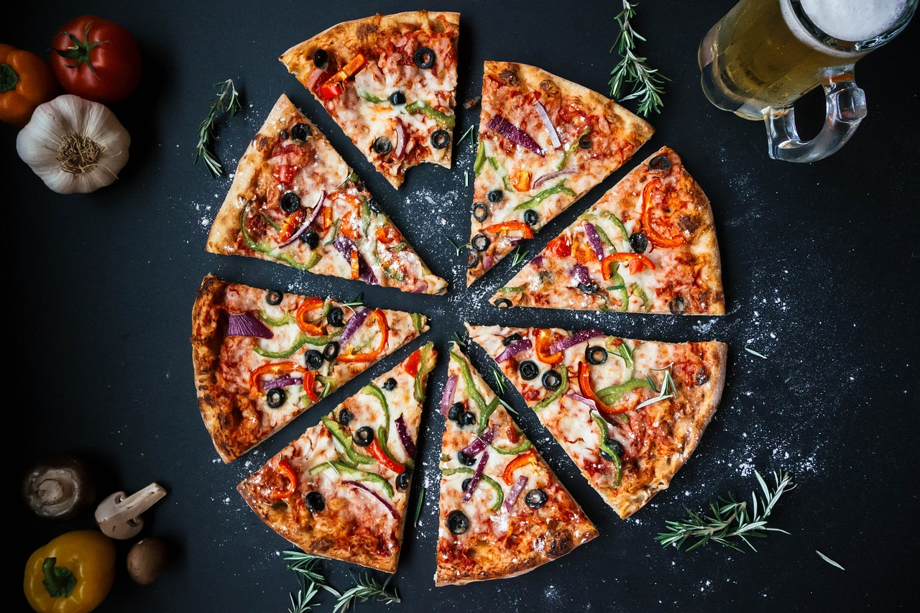
Pizza Sales Analysis
By Jay Prakash Giri

Slide 2

objectives
How many customers do we have each day? Are there any peak hours?
How many pizzas are typically in order? Do we have any bestsellers?
How much money did we make this year? Can we identify any seasonality in the sales?
Are there any pizzas we should take off the menu, or any promotions we could leverage?

Slide 3
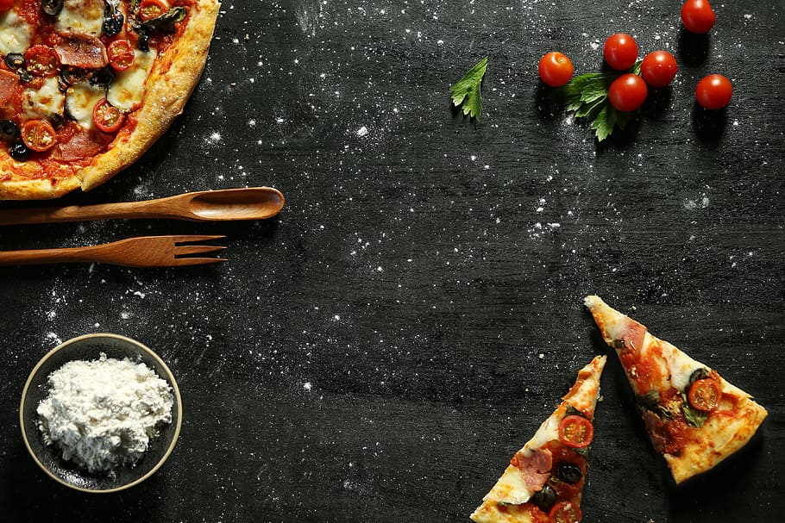
1
We have customer each day - 60
How many customers do we have each day? Are there any peak hours?
12:00 to 01:00 And 05:00 to 07:00

Slide 4
2
Typically pizza in order - 3
Best seller pizza – big_meat_s
How many pizzas are typically in order? Do we have any bestsellers?

Slide 5
3
Total Revenue - $801945
Can we identify any seasonality in the sales?
->May (8.68%) And July (9.06%)
How much money did we make this year? Can we identify any seasonality in the sales?

Slide 6
4
Are there any pizzas we should take off the menu, or any promotions we could leverage?
->we should take off the_green_xxl pizza
->provide a seasonal discount or special offer

Slide 7
Thank you
Contact information
Jay Prakash giri
9102030829
jaygiri0111@gmail.com
Dataset Link:
https://www.kaggle.com/datasets/mysarahmadbhat/pizza-place-sales

